Slide 1

Enhancing Mill Efficiency through Data Driven Insights K R NIJANDHAN 22f3003192
BUSIBUSINESS DATA MANAGEMENT CAPSTONE PROJECT

Slide 2
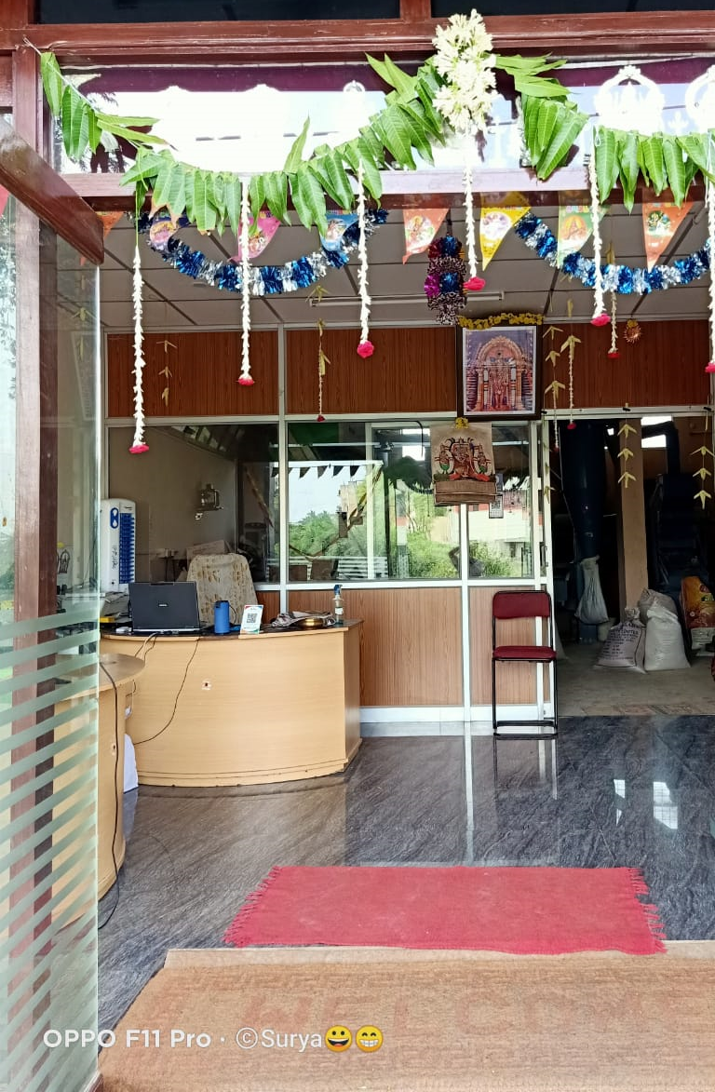
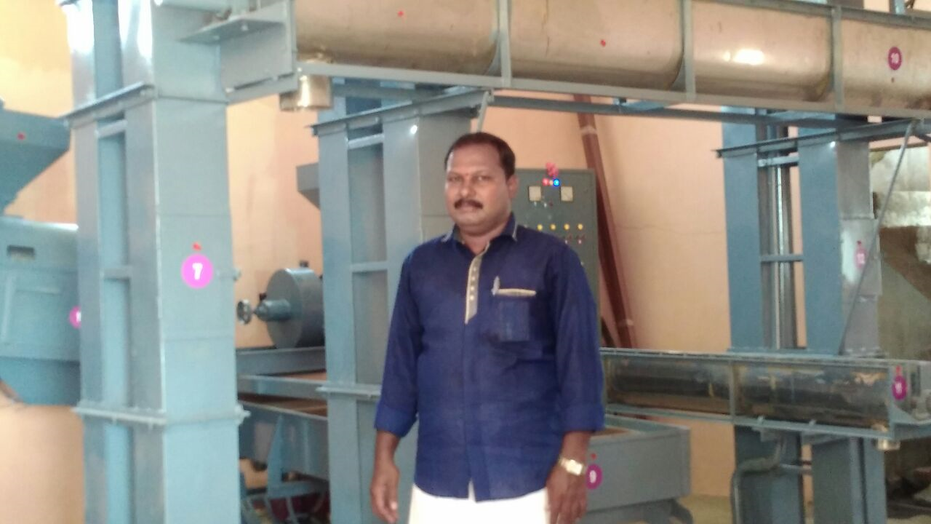
Subha Sree Rice Mill
About
B2B
Established in 2018 by Mr. Purushothaman
Located in Kanchipuram, Tamil Nadu
Five Employees
Process Rice and Dal
Business Issues
Challenges in evaluating performance of Suppliers
Production Planning is not optimal

Slide 3
Problem Statement
Enhance the Performance of Suppliers
Proper Production Planning
Automating the calculation of revenue from each supplier alleviates the manual burden, enhancing efficiency in business operations.
Strategic production planning is key for a mill's efficiency, minimizing downtime and optimizing processing capabilities.

Slide 4
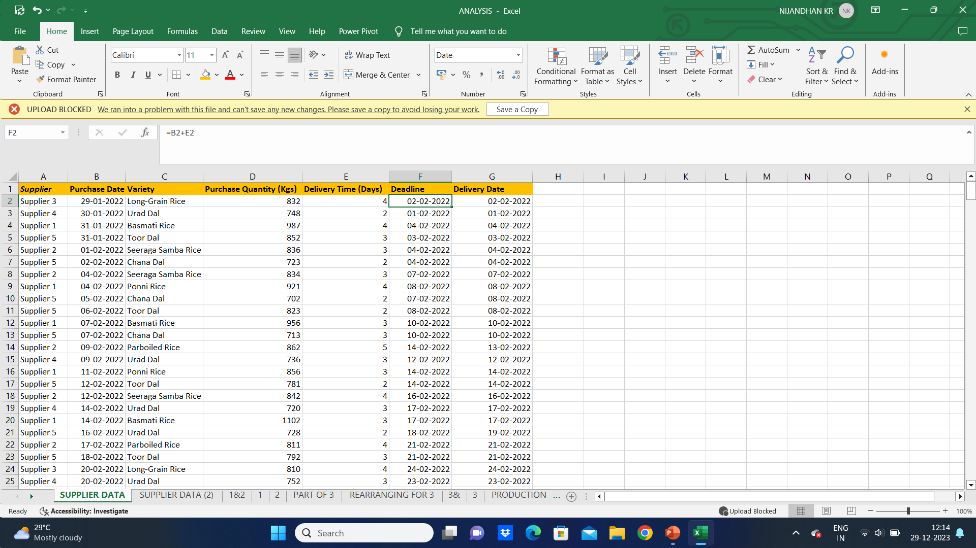
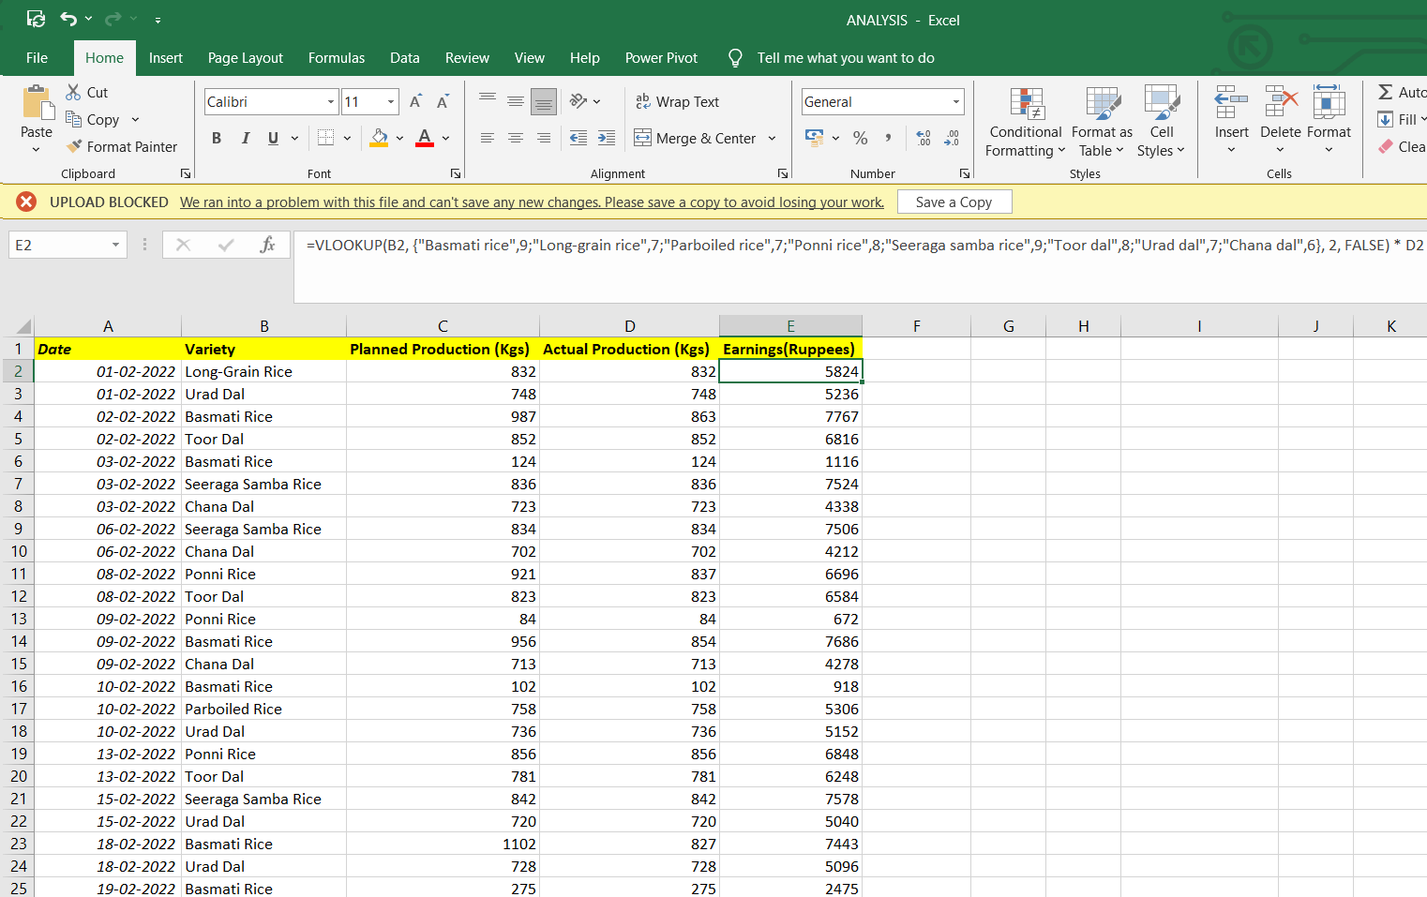
Data Collection and Analysis
Supplier Data Analysis
Production Data Analysis

Slide 5
Approach
Fetching the Data from Mill’s Record Notebook
1. Supplier data and Production Data – In Microsoft Excel using built-in functions such as VLOOKUP and Pivot Table Implementation.
Creating Graphs in Microsoft Excel
1. Bar charts
2. Pie charts
3. Box and Whisker Plot
4. Radar chart
5. Scatter Plot
Analysis
1. Market Analysis
2. Production Planning
3.Financial Analysis

Slide 6
Graphical Analysis

Slide 7
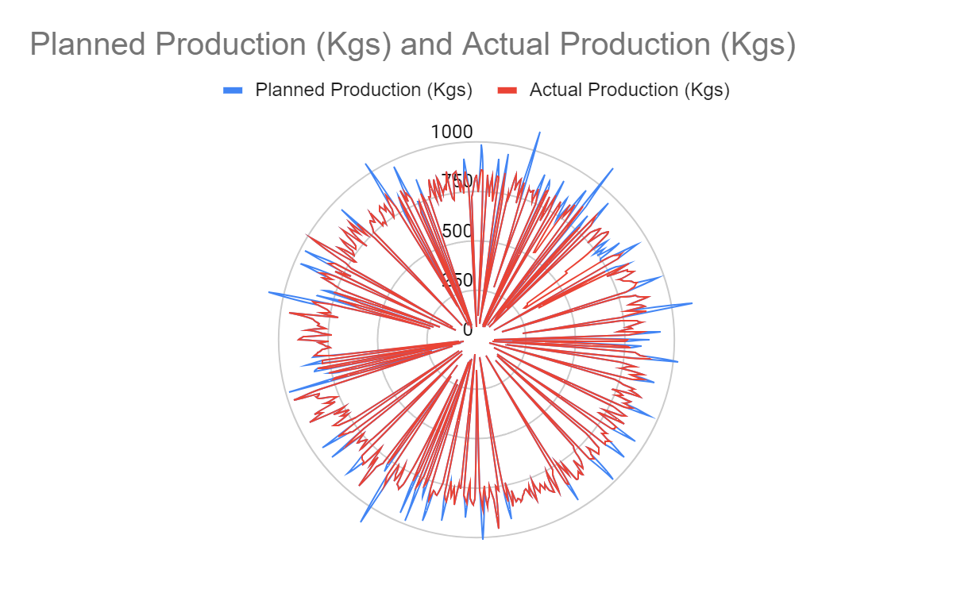
Graphical Analysis

Slide 8
Results and Findings
Significance of Suppliers
Supplier 1 and Supplier 5 contribute to over 56% of the Mills Earnings whereas Supplier 2 and Supplier 4 contribute around 36% and Supplier 3 contributing 8%.
Variety-Wise Earnings
Basmati Rice, Urad Dal and Toor Dal are considered as high value varieties as their contribution towards Mill’s revenue is very high compared to other varieties.
Revenue Analysis
The Mills revenue constantly fluctuates from January to October and then increases to a certain level in November and declines gradually in December.
Production Planning
The Mill struggles in production when the Planned Production exceeds 1 Ton. This can be seen in especially in Rice variety that is Basmati Rice. This leads to delayed deliveries.

Slide 9
Recommendations
Strengthen relationships with Supplier 1 and Supplier 5 for enhanced collaboration and favorable terms.
Prioritize processing efforts on Basmati Rice, Toor Dal, and Urad Dal to maximize profitability.
Implement an integrated production approach for simultaneous processing of Rice and Dal varieties.
Investigate and strategize solutions for overcoming struggles in production, especially when processing varieties exceeding 1 ton.
The Mill should focus on production of Rice varieties especially Basmati Rice in the month of November to maximize profit.
Conduct a detailed analysis of production processes to address delays and streamline operational efficiency.

Slide 10
Acknowledgment Many thanks to Mr. Purushothaman for providing me opportunity to work for his firm. I am grateful for his constant support. Last but not the least, I am thankful to IIT-Madras from the core of my heart for bringing up this course as this project instilled confidence in me to solve real world problems. Thank you!

